Slide 1
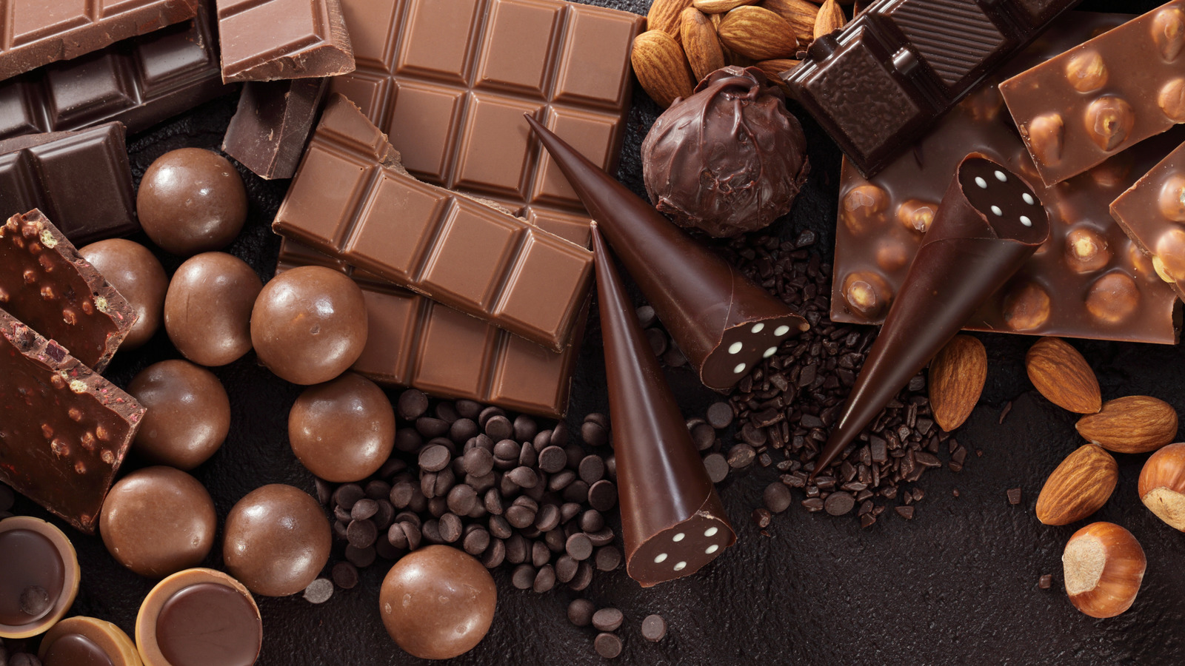


Yearly Report on Awesome Chocolates
Presented By-
SAGNIK SANYAL
www.linkedin.com/in/sagnik-sanyal

Slide 2
INSIGHTS
Sales Overview: The total sales volume for Awesome Chocolates reached $44 million, reflecting a robust market performance.
Customer Base: Our customer outreach expanded to 1 million, illustrating strong market penetration and consumer engagement.
Top Performing Region: New Zealand emerged as a standout market with the highest sales totaling $7,435,918, underscoring its strategic importance in revenue generation.
Customer Penetration: Analyzing customer penetration rates, the UK leads with 0.44, showcasing effective market reach. Conversely, the USA recorded a penetration rate of 0.41, indicating opportunities for growth in this key market.
Product Performance: Among Awesome Chocolates' products, Drinking Coco stands out with the highest low-box shipment percentage at 13.49%, reflecting strong consumer demand and product appeal.
Sales Team Performance: The Yummies team within Awesome Chocolates demonstrates exceptional sales performance, consistently meeting shipment targets and driving revenue growth.
Top Salesperson: Barry Faughny emerges as the top-performing salesperson, demonstrating outstanding sales acumen and contribution to overall team success.
Sales Forecast: Looking ahead, we anticipate a spike in customer acquisition in April 2022, projecting an increase to 80,000 customers. Expected sales for the period are estimated at $2,955,624, highlighting anticipated growth opportunities and strategic planning insights.

Slide 3
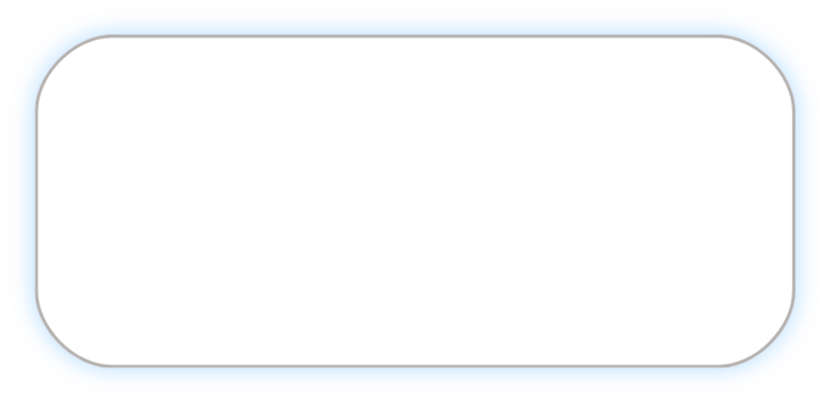

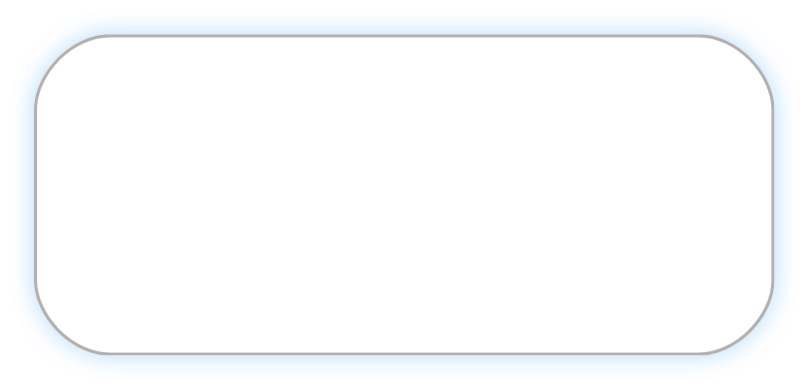
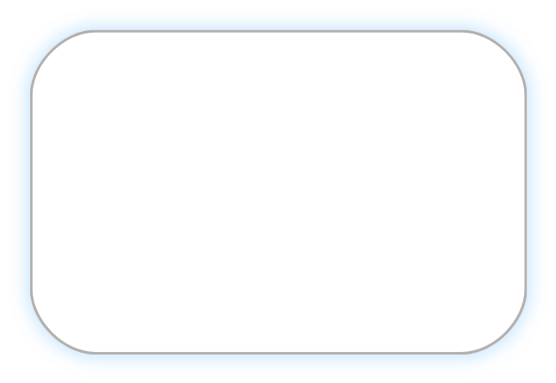
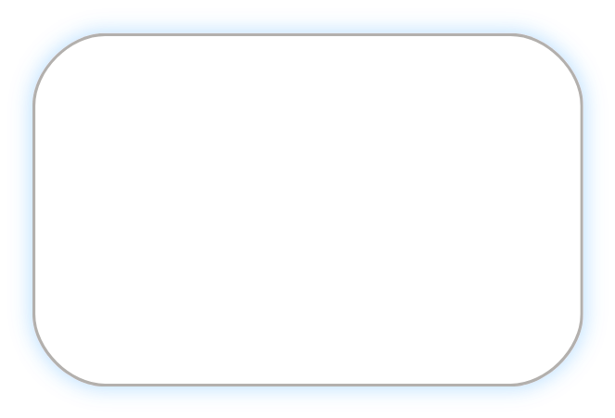
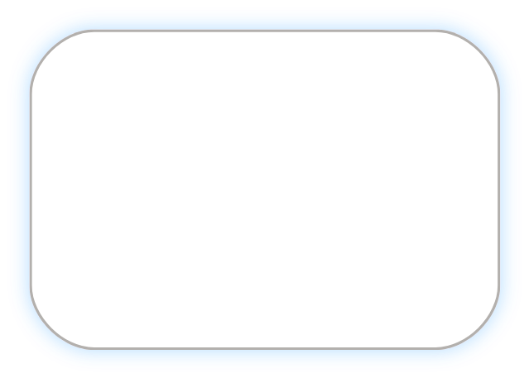






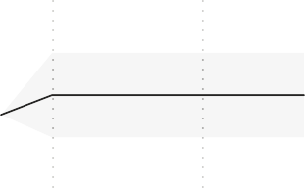

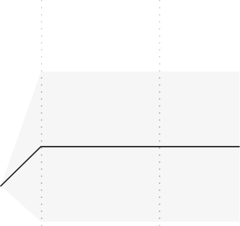


POWER BI DASHBOARD
Power BI Desktop
Total amount
$44M
Total Boxes sold
3M
Total Customers
1M
shipment count
8K
Low box shipments
728
Americas APAC Europe
Bars Bites Other
Location wise products performance
Shipment wise products Performance
Customer penetration by Geography
0.44
0.43
0.42
0.41
Geo
Delish | Jucies | New…
Yummies
Geo
Total
amount
Total Boxes sold

Amt per Amt per
Product
After Nines
Drinking Coco
70% Dark Bites
Peanut Butter Cubes
Fruit & Nut Bars
Manuka Honey Choco
Low Low-box shipment shipments % count

46
shipment box sold
Customer Penetatiton
12.96%
Region-wise Customers Trend
Americas APAC Europe
New Zealand | $74,35,918 | 493139 | 5,755.35 | 15.08
Canada | $73,50,091 | 491482 | 5,684.53 | 14.95
India | $73,10,254 | 490374 | 5,797.19 | 14.91
Australia | $72,63,151 | 482536 | 5,755.27 | 15.05
USA | $70,12,523 | 473759 | 5,646.15 | 14.80
UK | $71,89,609 | 470021 | 5,674.51 | 15.30
Total | $4,35,61,546 | 2901311 | 5,718.99 | 15.01
46
13.49%
Region
43
12.72%
40
11.27%
Total Customers
40K
UK
Canada
Australia
India
USA
20K
38
10.95%
New Zealand
38
10.76%
Jan 2021
Mar 2021
May 2021
Jul 2021
Year
Sep 2021
Nov 2021
Sales Forecast
Total amount
$5M
$3.2M
$3.0M
$5.3M
FRIDAY PERFORMAMCE
Amt per Shipment target
$3.0M
$2.9M
$2.3M
Top Performing SalesPerson
Picture Sales person Location
Barr Faughny Hyderabad
$2.5M
$2.4M
$2.0M
Product
Friday Sales Friday shipment

Sales person Team
Barr Faughny Yummies YES
YES YES YES YES
APS target?

$0M
Jan 2021
Apr 2021
Jul 2021 Oct 2021 Jan 2022 Apr 2022
Customer Forecast
Jul 2022
After Nines | $4,99,093 | 81
Drinking Coco | $4,85,128 | 75
99% Dark & Pure | $4,73,669 | 81
Orange Choco | $4,66,592 | 78
White Choc | $4,54,076 | 77
Caramel Stuffed Bars | $4,50,485 | 77
Milk Bars | $4,49,239 | 84
Manuka Honey Choco | $4,45,270 | 72
Total | $92,49,415 | 1618
Beverie Moffet Jucies
Camilla Castle Ches Bonnell Dennison
Crosswaite
Dotty Strutley Gigi Bohling Gunar
150K
149K
Ches Bonnell
Hyderabad
Total Customers
Yummies
100K
92K
79K
86K
Delish YES
Delish YES Yummies YES
81K
77K
70K
68K
60K
Dennison Crosswaite Hyderabad
50K
Jan 2021
60K
Jan 2022
Apr 2021
Jul 2021
Oct 2021
Year
Apr 2022
Jul 2022

